Slide 1

Data Analysis
By Nishant Pratap Singh

Slide 2


Introduction
This project explores the Netflix titles dataset using SQL queries to uncover patterns and insights about movies and TV shows available on the platform. The dataset contains information such as title, type, director, cast, country, release year, rating, duration, genre, and date added to Netflix. By applying structured SQL queries, the project demonstrates how to efficiently analyze large datasets and transform raw data into meaningful insights.

Slide 3


Objective
Data Exploration – Understand the structure of the Netflix dataset and identify key attributes for analysis.
Querying with SQL – Apply SQL techniques such as filtering, aggregation, grouping, and joins to answer analytical questions.
Content Insights – Analyze Netflix’s catalog distribution across movies and TV shows, release trends, and geographic patterns.
Category Classification – Categorize titles based on ratings, genres, and duration for better segmentation.
Trend Analysis – Explore how content additions vary across countries and years, highlighting Netflix’s global expansion.

Slide 4


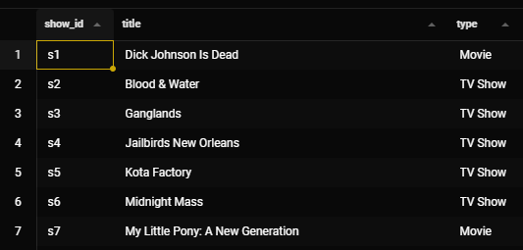
Listing Titles with Show ID, Title & Type
Select
show_id, title , type
From Netflix

Slide 5


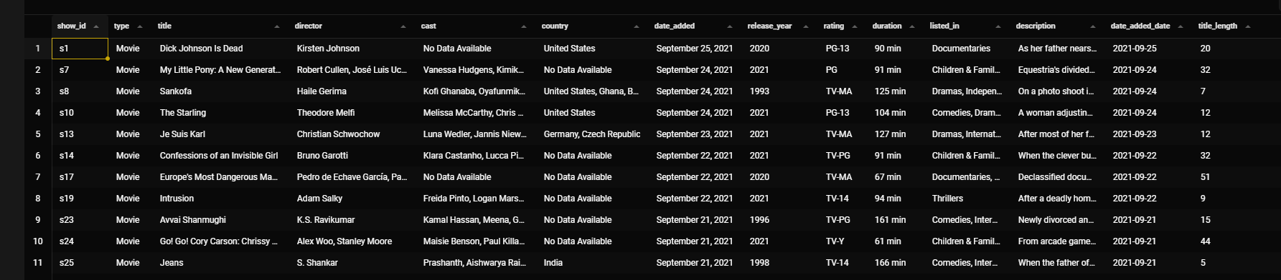
Displaying all columns for Movie Titles
Select *
From netflix
Where type = 'Movie' ;

Slide 6






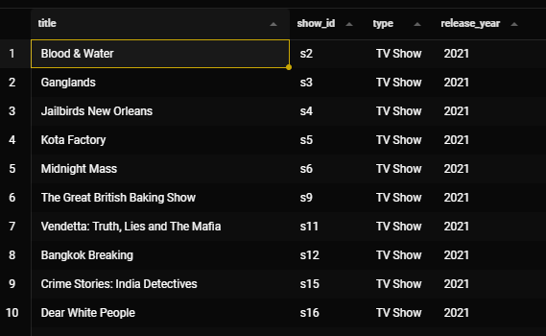

TV Shows released in 2021
Select title,show_id, type,release_year
From netflix
where type = 'Tv Show' and release_year = 2021 ;

Slide 7

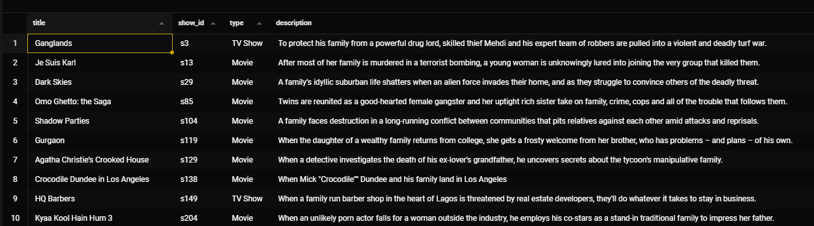
Title containing “Family” in Description
Select title,show_id, type,description
From netflix
Where description like '%family%' ;

Slide 8

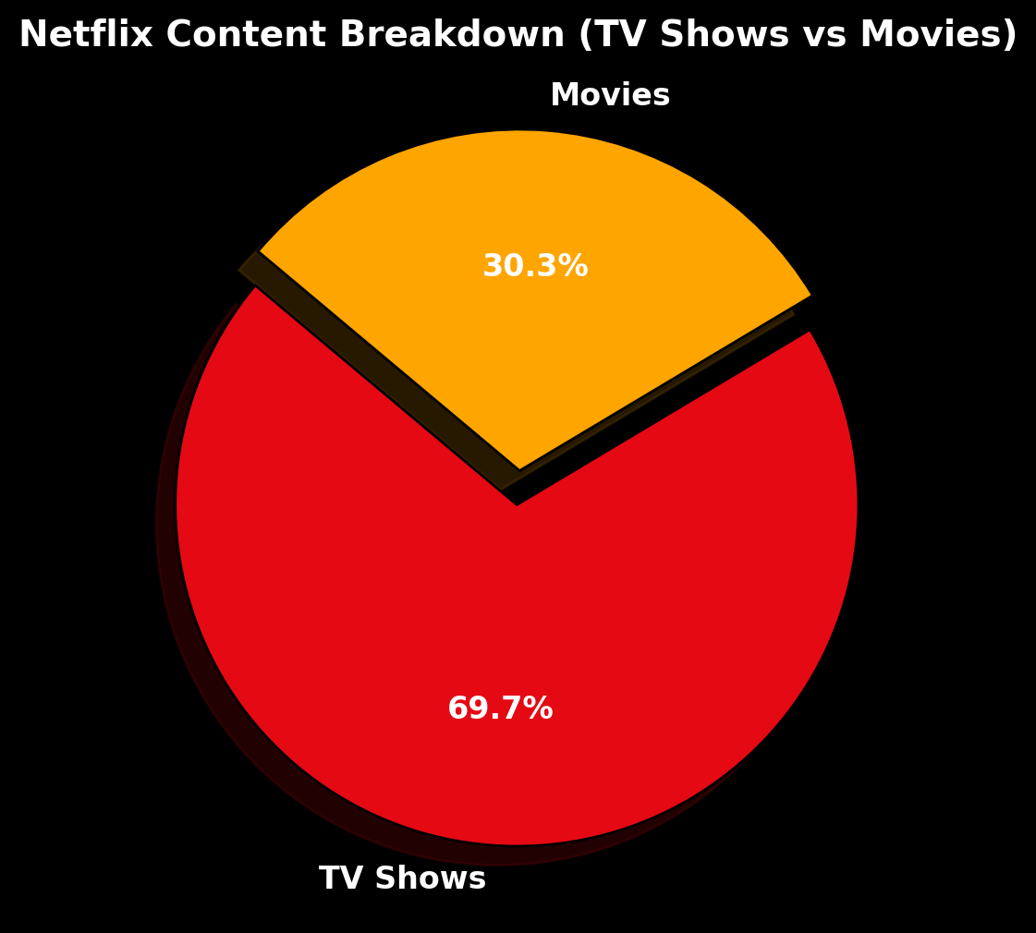
TV shows and Movies Breakdown
SELECT
type,
COUNT(*) AS count,
ROUND(100 * COUNT(*) / (SELECT COUNT(*) FROM netflix), 1) AS pct
FROM netflix
GROUP BY type
ORDER BY count DESC;

Slide 9









Total number of Titles
Select count(title) as total_title
From netflix;
8785

Slide 10





Average Movie Duration
Select avg(duration) as 'Average Duration'
From netflix
Where type = 'movie';
99.569 mins

Slide 11


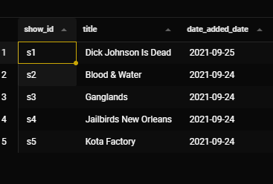




Top 5 Latest Titles
SELECT show_id, title, date_added_date
FROM netflix
Order by date_added_date desc
LIMIT 5;

Slide 12




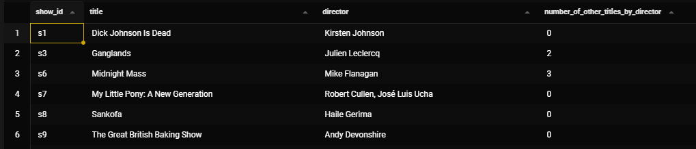
Titles by Director with Count
SELECT
n.show_id,
n.title,
n.director,
d.total_titles - 1 AS number_of_other_titles_by_director
FROM netflix n
JOIN (
SELECT director, COUNT(*) AS total_titles
FROM netflix
WHERE director IS NOT NULL AND director <> 'No Data Available'
GROUP BY director
) d
ON n.director = d.director;

Slide 13
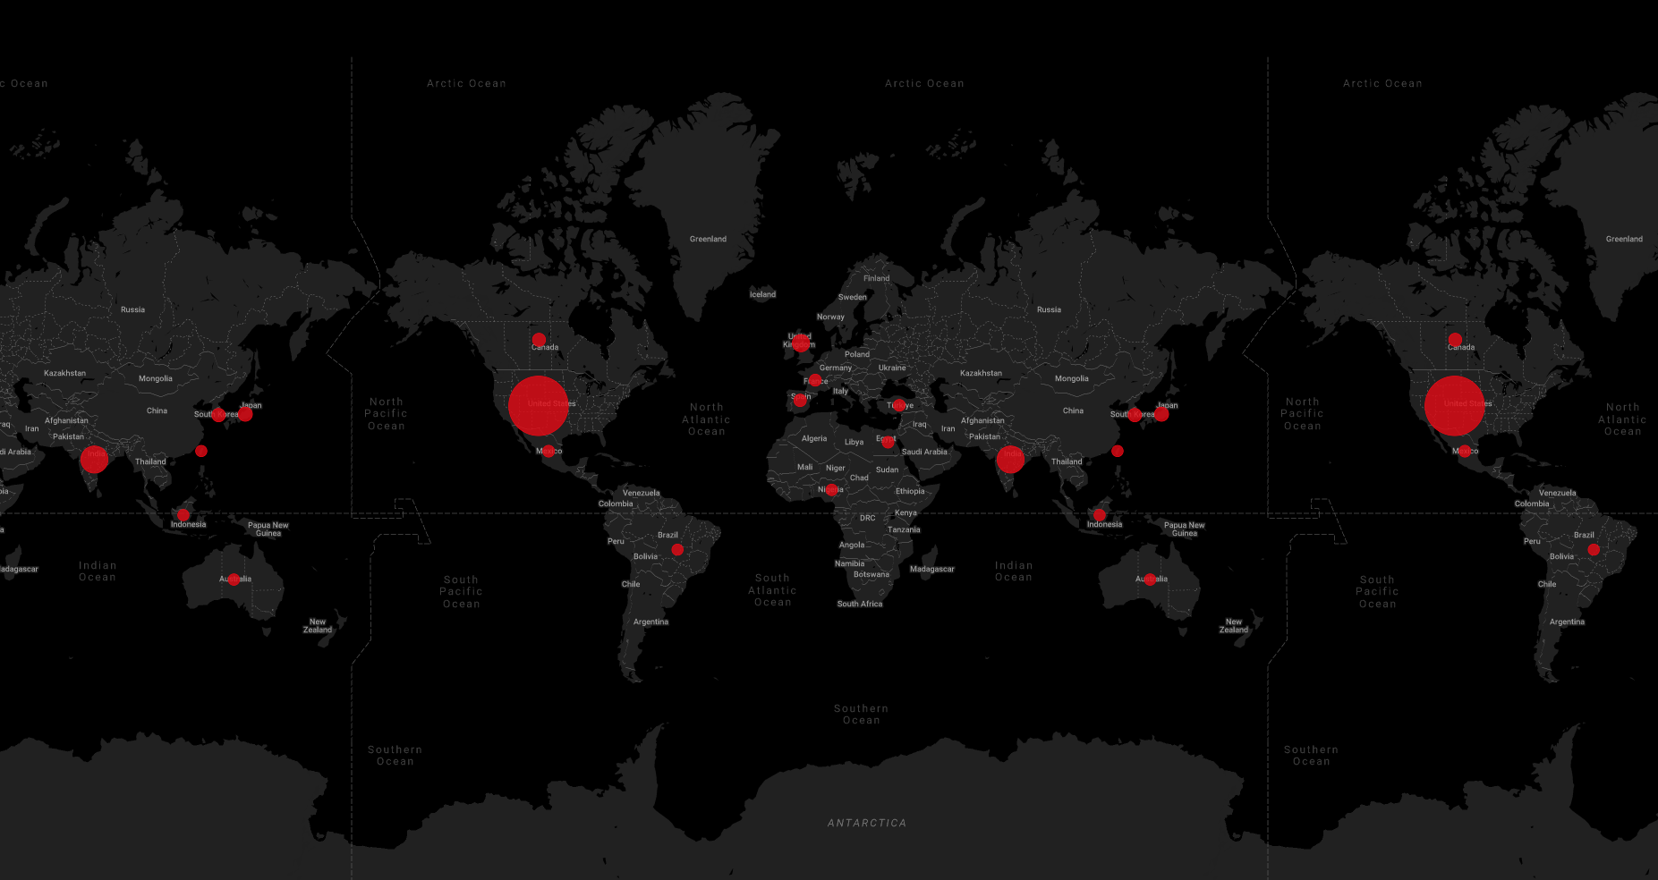

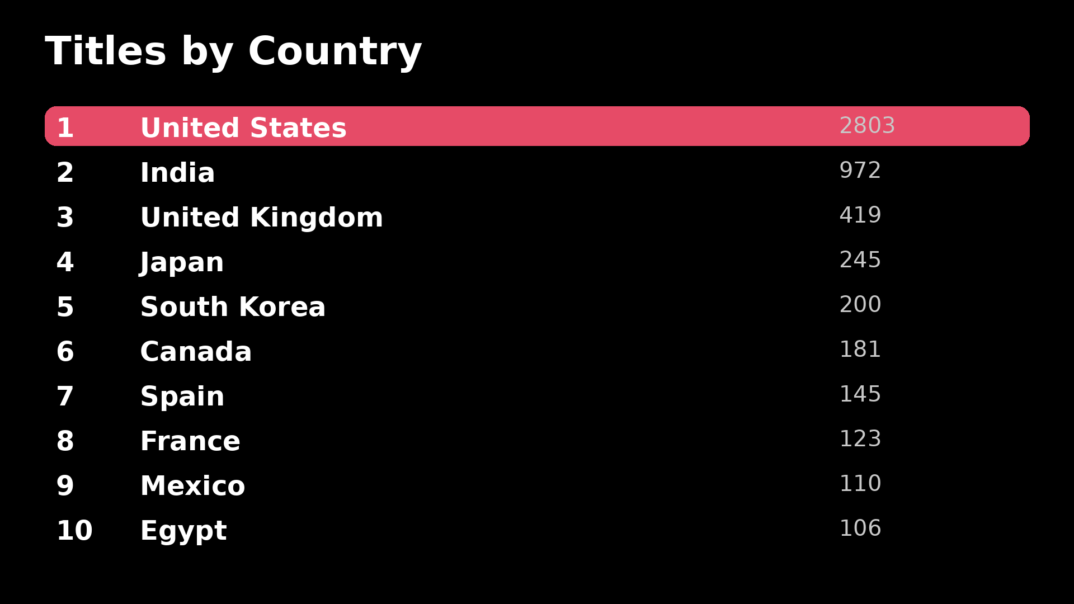
Titles by Country
SELECT country, count(*) as total_title
FROM netflix
WHERE country <> 'No Data Available'
GROUP BY country
ORDER BY total_title desc;

Slide 14
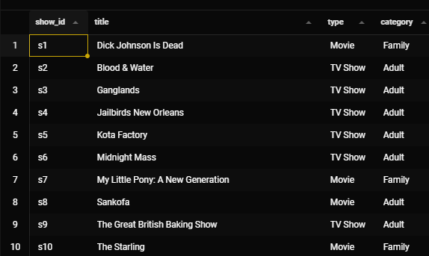
Titles Categories by Rating
SELECT show_id, title, type,
CASE
WHEN rating IN ("G", "PG", "PG-13") THEN "Family"
WHEN rating IN ("TV-Y", "TV-Y7", "TV-G") THEN "Kids"
ELSE "Adult"
END AS category
FROM netflix;

Slide 15

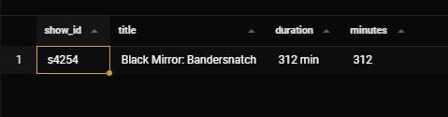

Longest Title Duration
SELECT show_id, title, duration,
CAST(SUBSTRING_INDEX(duration, ' ', 1) AS UNSIGNED) AS minutes
FROM netflix
WHERE duration LIKE '%min%'
ORDER BY minutes DESC
LIMIT 1;

Slide 16







Key Findings
Catalog Size: The dataset provides thousands of Netflix titles, with a higher share of Tv shows compared to Movies.
Release Trends: A large number of titles were added in recent years, indicating Netflix’s aggressive content expansion strategy.
Average Movie Duration: The typical Netflix movie has an average runtime of ~99 minutes, fitting within standard feature-length duration.
Top Contributors: Certain directors and countries (like the United States and India) contribute significantly more content compared to others.
Category Segmentation: By classifying titles into Family, Kids, and Adult categories using ratings, clear distinctions emerge in Netflix’s target audiences.
Global Distribution: The U.S. dominates Netflix’s catalog, but countries like India, the U.K., and Japan also emerge as strong contributors.
Hidden Insights: Analysis of genres shows that certain regions (e.g., South Korea, Spain) have a higher diversity of genres per title, highlighting localized content richness.

Slide 17







Thank You!

